Slide 1
SAT 5424 PHI
Leveraging Health Informatics and AI to enhance preventive healthcare and disease management
Presenters: Gideon Owusu,
David Blemano
Date: April 15, 2025

Slide 2
Introduction
• Chronic diseases affect 60% of Americans.
• Barriers to healthcare access and early detection persist.
Disparities and high cost of quality healthcare access
• This study explores how health informatics (HI) and AI improve early detection, management, and outcomes.

Slide 3
Objectives
• Assess AI’s impact on healthcare quality.
• Evaluate mobile health's role in preventive care.
• Examine Telemedicine and remote patient monitoring (RPM) in chronic disease control.
• Investigate how HI reduces healthcare disparities in the U.S.

Slide 4
Literature Review
The healthcare sector has been transformed by AI by shifting its focus beyond diagnosis towards preventive healthcare and early detection. Potential health risks can be identified easily and early by leveraging AI prior to the full onset of symptoms. This improves patient outcomes, reduces healthcare costs, improves quality of life, and is free from complications (Shukla, 2024)
One of the greatest injustices is health inequity. A clear disparity exists between African Americans and Caucasians in assessing specialty consultations. This disparity extends to the treatment of chemotherapy-related cardiovascular complications among these groups. Different aspects of digital transformation and health informatics have the potential to eliminate these disparities and promote health equality (Sherry-Ann et al, 2022).
Saxena et al. (2023), Health Informatics plays a significant role in improving patient care and enhancing healthcare systems. Researchers employ HI to design electronic health records for string patients' medical treatments, diagnoses, laboratory results, and medical history. AI in healthcare can improve diagnostic processes, predict disease progression, and recommend evidence-based treatment plans.
The three pillars of preventive medicine comprise primary, secondary, and tertiary, will be achieved with advanced technologies, AI, telemedicine, and wearable devices. Research in Breast Cancer and Diabetes has proven how these technologies have been implemented to provide precise preventive care, isolating at-risk groups and recommending personalized preventive and healthy lifestyles to improve quality of life. Currently, health informatics, big data, and medical digitalization will permit the recommendations of personalized preventive treatment plans based on a person’s biological, genomic, and clinical information (De La Torre K et Lee H, 2025).

Slide 5
Role of Health Informatics
• Combines healthcare, IT, and data science.
• Enhances decision-making and patient outcomes.
• Key components: EHRs, CDSS, HIE, Wearable Devices, telemedicine, predictive analytics.

Slide 6
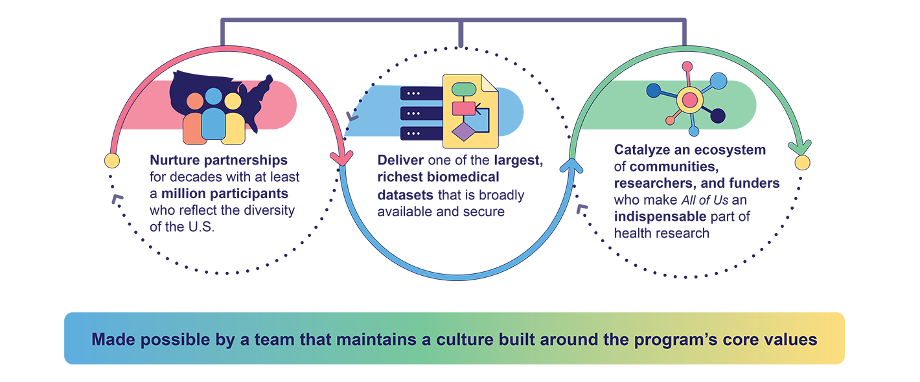
AI, Big Data & Predictive Analytics
• AI enables early detection and personalized care.
• Predictive analytics forecast disease risk.
• Big data uncovers health trends for population health strategies.
The All of Us project – To collect 1 million healthcare data to enhance precision medicine

Slide 7
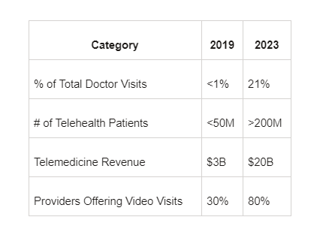
Telemedicine
expanded access to healthcare, particularly in remote or underserved areas
Telemedicine allows for virtual consultations between patients and healthcare providers
mHealth apps help patients manage their health daily by providing tools for monitoring diet, exercise, mental well-being, and medication adherence

Slide 8
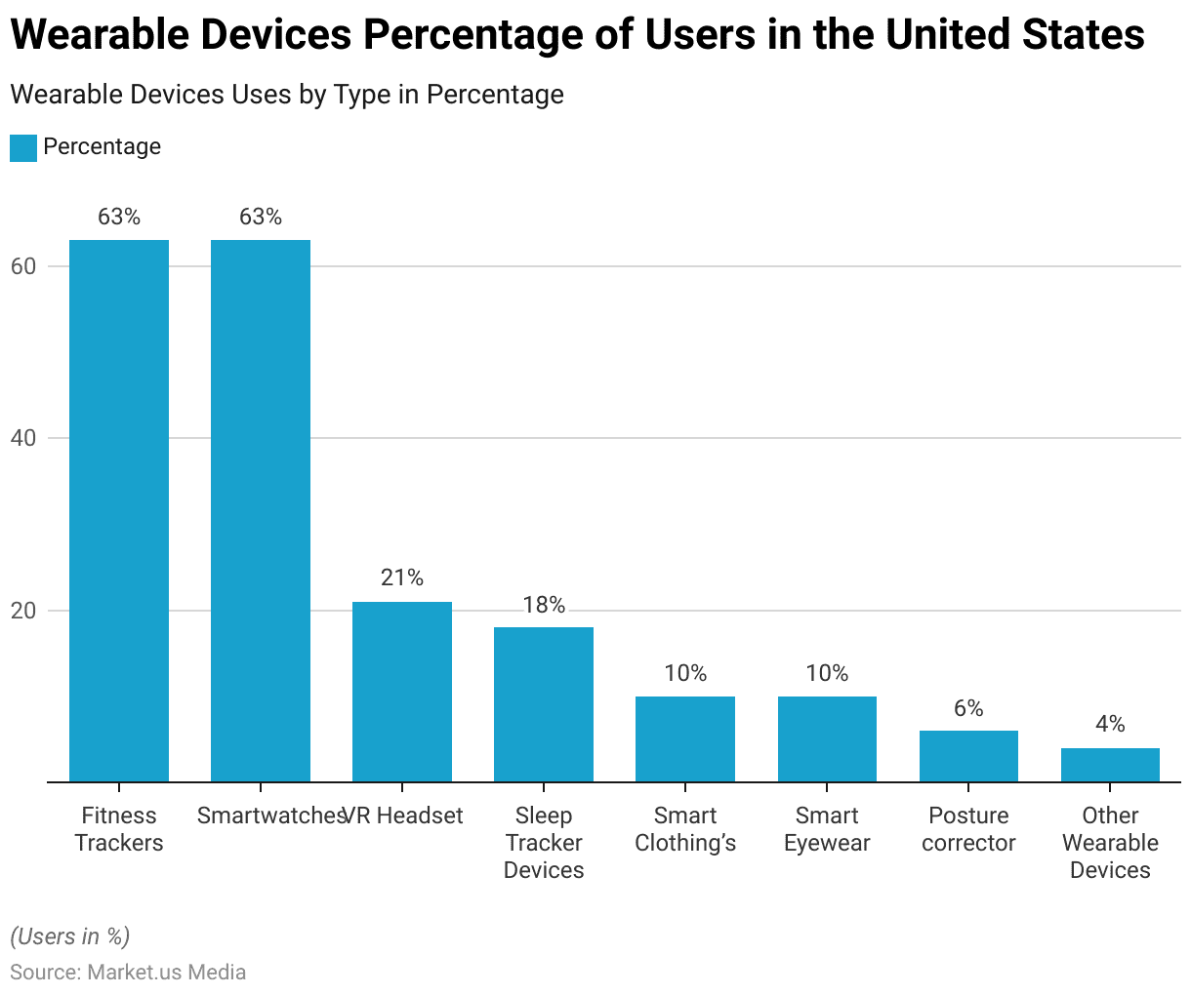
Wearable devices
Devices like smartwatches, continuous glucose monitors (CGMs), blood pressure monitors, and Fitness Trackers
Alert users about potential health issues before they become serious
allow healthcare providers to monitor patients outside of clinical settings

Slide 9
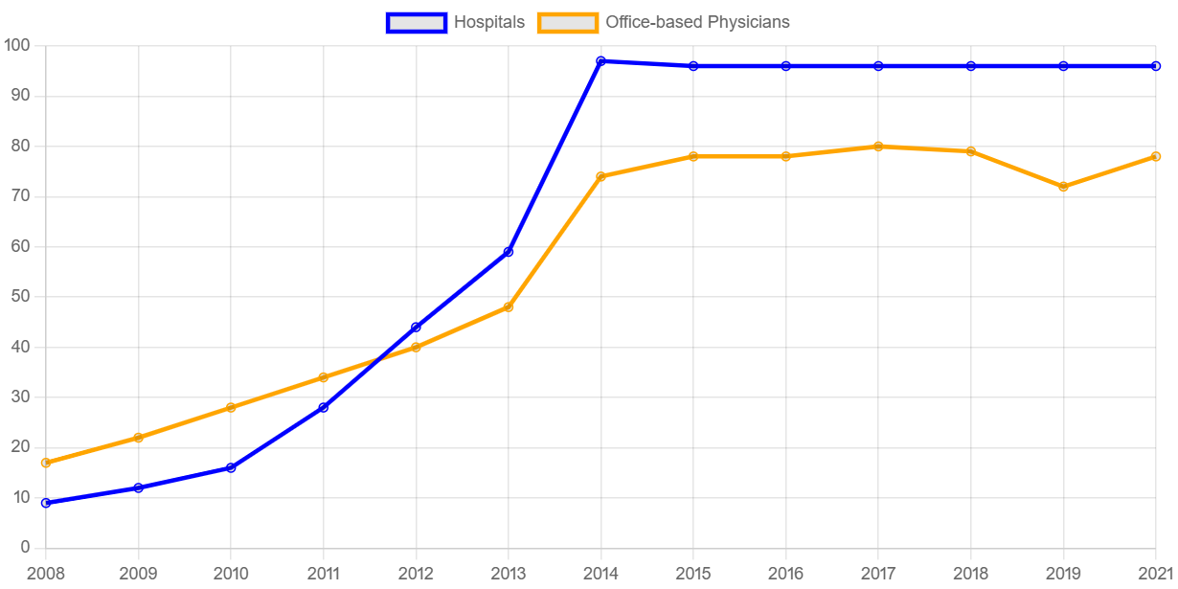
EHR
Store critical information such as medical history, lab results, and medications essential for preventive and disease management
Updated health records, reducing errors and improving decision-making
EHR usage is influenced by the HITECH Act, which provided financial incentives to healthcare providers to adopt EHR

Slide 10

Benefits of Health Informatics
• Improved care quality and safety.
• Reduced costs and paperwork.
• Greater access for remote communities.
• Personalized and predictive healthcare solutions.

Slide 11

Challenges
• Data privacy and security.
• Interoperability issues between systems.
• High costs and resistance to change.
• Ethical concerns with AI recommendations.

Slide 12

Future Trends
• IoT and genomics for precision medicine.
• Augmented/Virtual Reality for clinical training and monitoring.
• Integration of AI and blockchain in real-time care.

Slide 13

Conclusion
• HI and AI are critical for modern chronic disease prevention and management.
• Emphasize accessibility, personalization, and efficiency.
• Continued innovation will drive equitable healthcare transformation.

Slide 14
References
1. Shukla, Tanmay. (2024). Beyond Diagnosis: AI’s Role in Preventive Healthcare and Early Detection. 8.
https://www.researchgate.net/profile/Tanmay-Shukla-6/publication/386141427_Beyond_Diagnosis_AI's_Role_in_Preventive_Healthcare_and_Early_Detection
2. https://www.sciencedirect.com/science/article/pii/S2666602222000775
3. Saxena, Pushkarprabhat & Mayi, Krishna & Arun, R & Kumar, Mr & Biswo, Dr & Mishra, Biswo & Praveen, Kb. (2023). Impact of Artificial Intelligence on Healthcare Informatics: Opportunities and Challenges. Journal of Informatics Education and Research. 3. 2309. 10.52783/jier.v3i2.384. https://www.researchgate.net/publication/376601831_Impact_of_Artificial_Intelligence_on_Healthcare_Informatics_Opportunities_and_Challenges
4. De la Torre K, Min S, Lee H, Kang D
The Application of Preventive Medicine in the Future Digital Health Era
J Med Internet Res 2025;27:e59165
URL: https://www.jmir.org/2025/1/e59165
DOI: 10.2196/59165
5.https://www.healthit.gov/data/quickstats/national-trends-hospital-and-physician-adoption-electronic-health-records
6. https://www.consagous.co/blog/evolution-of-telemedicine-from-2019-to-2023
7. https://media.market.us/wearable-medical-devices-statistics/
8. https://www.healthit.gov/data/data-briefs/interoperable-exchange-patient-health-information-among-us-hospitals-2023

